Slide 1
Deep Neural Networks
and
Transfer Learning

Slide 2
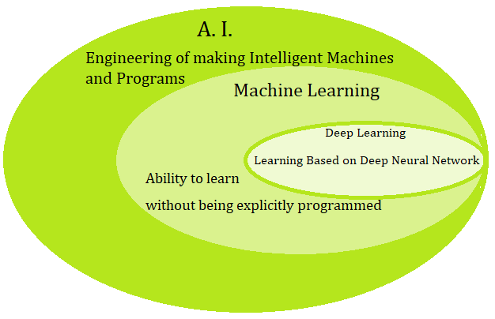
Deep Learning

Slide 3
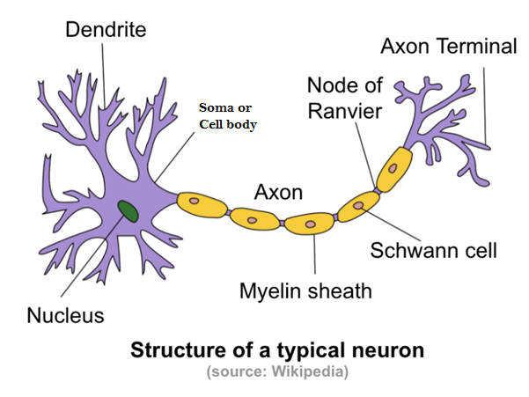
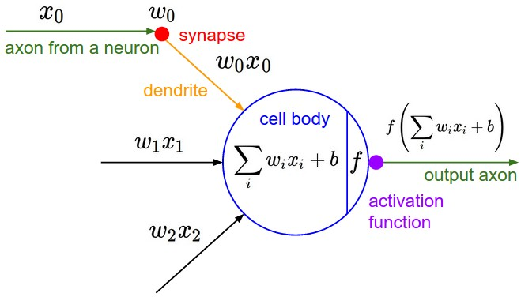
Biological Inspiration
Image Source: http://www.andreykurenkov.com/writing/ai/a-brief-history-of-neural-nets-and-deep-learning/

Slide 4
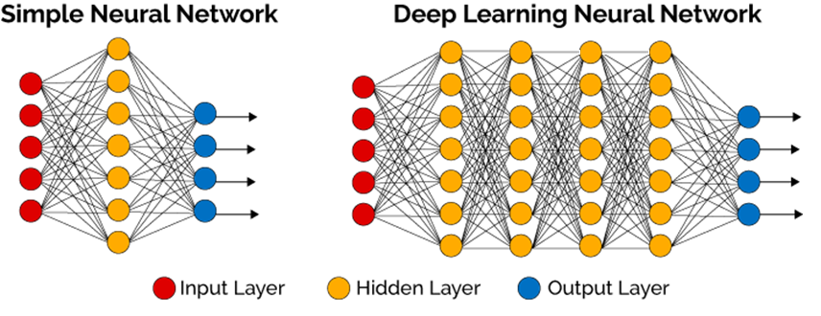
Deep Learning – A Definition
Deep Learning is a subﬁeld of Machine Learning which uses computational models, with hierarchical architectures composed by multiple processing layers, to learn representations of complex data such as images, sound and text.
Image Source: https://www.linkedin.com/pulse/intuition-deep-neural-networks-abhishek-parbhakar

Slide 5
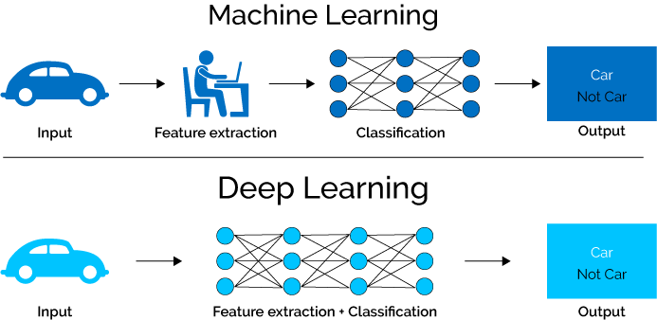
Difference between ML and DL
Image Source: https://www.xenonstack.com/blog/log-analytics-with-deep-learning-and-machine-learning

Slide 6
Continue…
Data dependencies
ML
Traditional machine learning algorithms with their handcrafted rules succeed in this scenario.
DL
When the data is small, deep learning algorithms don’t perform that well. This is because deep learning algorithms need a large amount of data to understand it perfectly.

Slide 7
Continue…
Hardware dependencies
ML
Traditional machine learning algorithms can work on low-end machines.
DL
Deep learning algorithms heavily depend on high-end machines because deep learning algorithms inherently do a large amount of matrix multiplication operations. These operations can be efficiently optimized using a GPU because GPU is built for this purpose.

Slide 8
Continue…
Feature engineering
ML
Most of the applied features need to be identified by an expert and then hand-coded as per the domain and data type.
For example, features can be pixel values, shape, textures, position and orientation. The performance of most of the Machine Learning algorithm depends on how accurately the features are identified and extracted.
DL
Deep learning algorithms try to learn high-level features from data.
deep learning reduces the task of developing new feature extractor for every problem. Like, Convolutional NN will try to learn low-level features such as edges and lines in early layers then parts of faces of people and then high-level representation of a face.

Slide 9
Continue…
Problem Solving approach
ML
Traditional machine learning is generally recommended to break the problem down into different parts, solve them individually and combine them to get the result.
For object detection problem, you would divide the problem into two steps, object detection and object recognition.
DL
Deep learning in contrast advocates to solve the problem end-to-end.
Image would be passed to network as an input, and it would give out the location along with the name of object. (i.e. YOLO net)

Slide 10
Continue…
Execution time
ML
Machine learning comparatively takes much less time to train, ranging from a few seconds to a few hours.
DL
A deep learning algorithm takes a long time to train. This is because there are so many parameters in a deep learning algorithm that training them takes longer than usual.
State of the art deep learning algorithm ResNet takes about two weeks to train completely from scratch.

Slide 11
Continue…
Interpretability
ML
Easy to interpret the reasoning behind it.
DL
No one interprets what happens in a node of DL model.
Let’s take an example. Suppose we use deep learning to give automated scoring to essays. The performance it gives in scoring is quite excellent and is near human performance. But there’s is an issue. It does not reveal why it has given that score. Indeed mathematically you can find out which nodes of a deep neural network were activated, but we don’t know what there neurons were supposed to model and what these layers of neurons were doing collectively. So we fail to interpret the results.
On the other hand, machine learning algorithms like decision trees give us crisp rules as to why it chose what it chose, so it is particularly easy to interpret the reasoning behind it. Therefore, algorithms like decision trees and linear/logistic regression are primarily used in industry for interpretability.

Slide 12
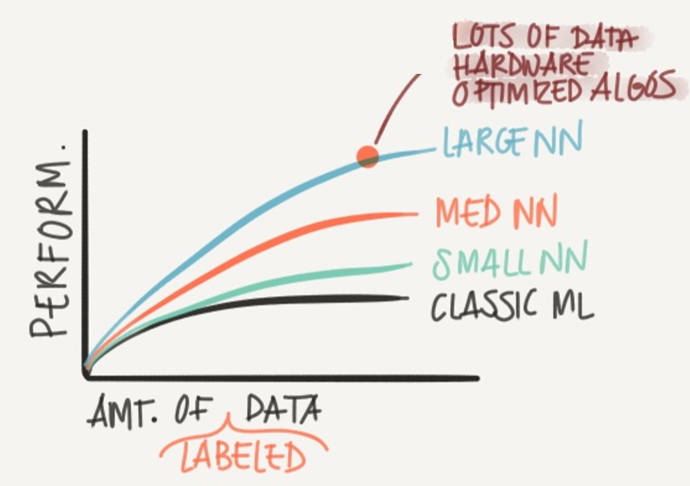
Why Deep Learning taking off?
Lots of Data – Structured and Unstructured
Computation Power – GPU
Efficient Algorithms

Slide 13
Why deep representations?
Deep NN makes relations with data from simpler to complex.
In each layer it tries to make a relations between the previous layer.
Face recognition application:
Image ==> Edges ==> Face parts ==> Faces ==> desired face
Audio recognition application:
Audio ==> Low level sound features ==> Phonemes ==> Words ==> Sentences
Neural Researchers thinks that deep neural networks thinks like brains (Simple ==> Complex)

Slide 14
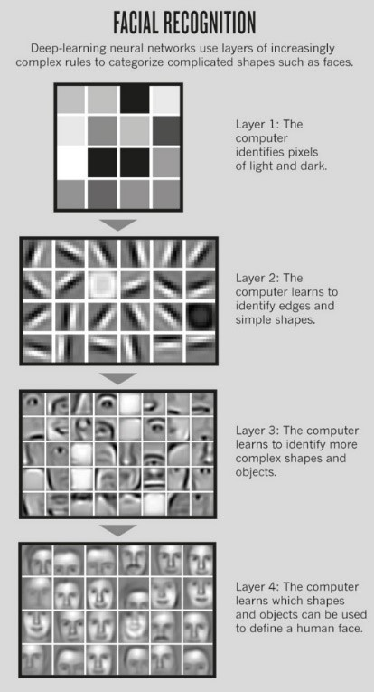
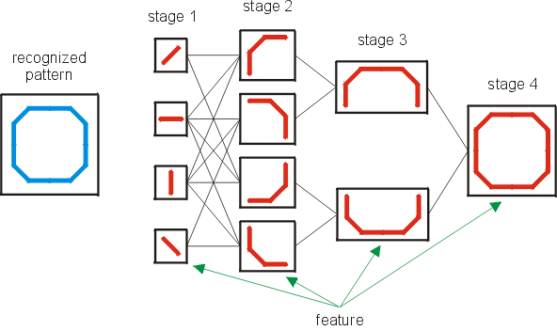
Image Source: https://www.kiv.zcu.cz/studies/predmety/uir/NS/Neocognitron/en/hierarch-det.html

Slide 15
Iterations, Epoch and Batch Size
batch size = the number of training examples in one forward/backward pass. The higher the batch size, the more memory space you'll need.
number of iterations = number of passes, each pass using [batch size] number of examples. To be clear, one pass = one forward pass + one backward pass (we do not count the forward pass and backward pass as two different passes).
one epoch = one forward pass and one backward pass of all the training examples.
Example: if you have 5000 training examples, and your batch size is 32, then it will take 157 iterations to complete 1 epoch.
5000/32 = 156.25 =157 iterations (156 x 32 + 1 x 8)
If you set epoch = 20, 20 x 157 = 3140 iterations

Slide 16
List of Parameters and Hyperparameters
Parameters - Weight and Bias
Hyperparameters (parameters that control the algorithm):
No of hidden layers - Try and error
No of neurons in each hidden layer - Try and error
Learning rate. (The most important parameter) – 0.1, 0.01, 0.001, 0.0001, .00001
Activation functions – Sigmoid, Relu, Leaky Relu, Tanh
Number of iteration – Try and error
Epoch – Try and error
Batch size – 4, 8, 16, 32, 64, 128… (Power of 2)
Regularization – Dropout, L1, L2
Regularization Rate and Dropout lambda
Normalizing inputs – Min-max, mean, Z-Score
Weights and Bias Initialization – Zero, Random, He
Optimization algorithm – SGD, ADAM, RMSProp
Learning Rate decay
Momentum – 0.9
Kernal size - 3 x 3 or 5 x 5
Number of filters - 32, 64, 128, etc..
Stride - 1, 2 or 3
Padding size - 0, 1, 2
Number of iterations, epoch and batch size

Slide 17
Comparison of Deep Learning Library
Software | Creator | Software license | Open source | Platform | Written in | Interface | CUDA support
TensorFlow [27] | Google Brainteam | Apache 2.0 | Yes | Linux, Mac OS, Windows | C++,Python | Python, (C/C++public API only for executing graphs) | Yes
Keras [28] | François Chollet | MIT license | Yes | Linux, Mac OS, Windows | Python | Python | Yes
Deeplearning4j [29] | Adam Gibson | Apache 2.0 | Yes | Linux, Mac OS, Windows, Android (Cross-platform) | C, C++ | Java, Scala | Yes
Caffe [30] | Yangqing Jia | BSD License | Yes | Linux, Mac OS, Windows | C++ | Python, Matlab | Yes
Theano [31] | Université de Montréal | BSD License | Yes | Cross-platform | Python | Python | Yes
Torch [32] | Ronan Collobert,Kavukcuoglu, Clement | BSD License | Yes | Linux, Mac OS, Windows, Android, iOS | C, Lua | Lua, C, utility library for C++/OpenCL | Yes
Microsoft Cognitive Toolkit - CNTK [33] | Microsoft Research | MIT license | Yes | Windows, Linux | C++ | Python, C++, Command line, BrainScript(.NET on roadmap) | Yes

Slide 18
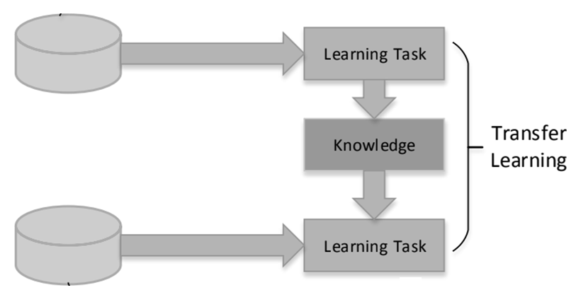

Mathematical Definition of Transfer Learning
D (Domain) : Feature space χ and P(X), where X = {x₁, ..., x_{n}} ∈ χ
Supervised Learning Task: [D = {χ, P(X)}, T = {Y, f(.)}] [7]
where, Y = $∀$y_{i},
f(.) = $τ${x_{i}, y_{i}}, where $τ$is training model, x_{i} ∈ X and y_{i} ∈ Y.
T_{S}
D_{S}
D_{S} : Source Domain
T_{S} : Source Learning Task
D_{T} : Target Domain
T_{T} : Target Learning Task
f_{T}(.)
D_{T}
where D_{S} ≠ D_{T}, or T_{S} ≠ T_{T}
T_{T}

Slide 19
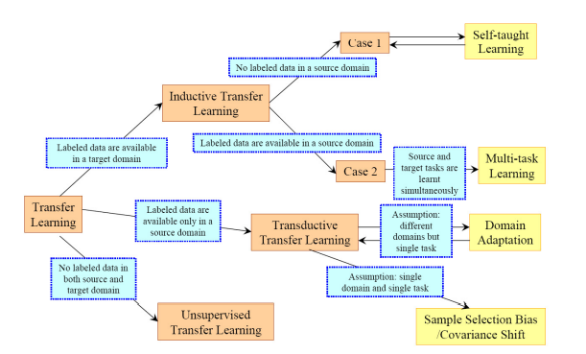
Types of Transfer Learning
Transfer Learning Strategies[24]

Slide 20
Contd…
Karl Weiss et. al is divided transfer learning in two type of approaches which are homogeneous transfer learning and heterogeneous learning [25].
Homogeneous transfer learning: The heterogeneous transfer learning solutions are focused on aligning the input spaces of the source and target domains with the assumption that the domain distributions are the same.
Heterogeneous transfer learning: Heterogeneous transfer learning is the scenario where the source and target domains are represented in different feature spaces.

Slide 21
The three major Transfer Learning scenarios are as follows [26]:
ConvNet as fixed feature extractor - Remove the output layer and then use the entire network as a fixed feature extractor for the new data set.
Fine-tuning the ConvNet - Keep the weights of initial layers of the model frozen while we retrain only the higher layers.
Pretrained models - Use architecture of the model while initializing all the weights randomly and train the model according to new dataset.

Slide 22
Ways to proceed on using the pre-trained model
Transfer Learning on New Dataset | Similar to the original dataset | Very different from the original dataset
Small | Fine-tune the fully-connected and output dense layers of pre-trained model | Fine-tune the initial layers of pre-trained model
Large | Fine-tune through the full network. | Train a ConvNet from scratch

Slide 23
3) Research issues of Transfer Learning
How many layers needs to freeze and re-train/fine-tuned the number of layers?
Change in values of hyperparameters or number of layers
Sample Data Similarity
One shot/ Few Learning - Where the training sample(s) is/are one/less
Trained model parameters for real-time video analysis - BFLOPs
Transfer the knowledge from video to video
Negative transfer learning
Transfer learning from multiple source domains.
Total weights or size of trained file.

